Slide 1
Link Analysis and spam
Slides adapted from
  Information Retrieval and Web Search, Stanford University, Christopher Manning and Prabhakar Raghavan
  CS345A, Winter 2009: Data Mining. Stanford University, Anand Rajaraman, Jeffrey D. Ullman

Slide 2
Query processing
Relevance: retrieve all pages meeting the query, and order them with relevance (based on e.g., vector space model)
Popularity: order pages by their link popularity
Combination: merge the results using popularity and relevance

Slide 3
Query-independent ordering
First generation: using link counts as simple measures of popularity.
Two basic suggestions:
  Undirected popularity:
    page score = the number of in-links plus the number of out-links (3+2=5).
  Directed popularity:
    Score of a page = number of its in-links (3).

Slide 4
Voting by in-links
The importance of a page can not be decided only by the internal features of the page
The ‘quality’ can be judged from links pointing to the page
Link is an implicit endorsement
Link may convey different meanings
  May be criticism, paid ad
  In aggregate, it is a collective endorsement.

Slide 5
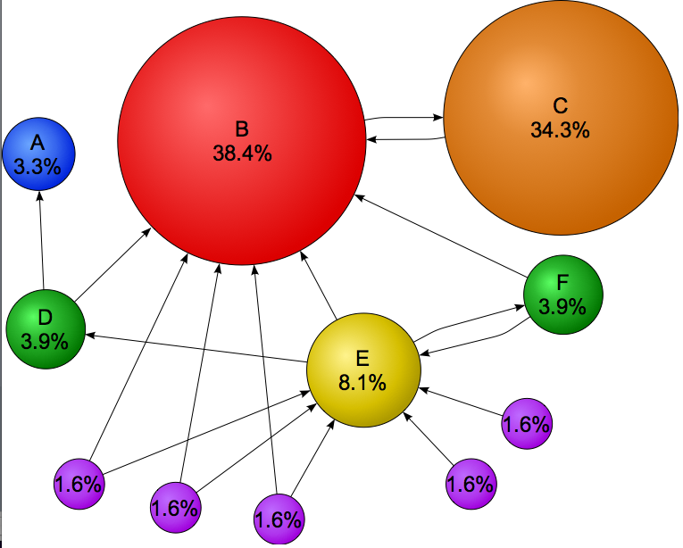
Pagerank
in-links are not equal, because
  Web pages are not equally “important”. A vote from an important page weighs more than a less important page (if same number of votes are casted)
  A vote weighs more if the page gives only few votes (links)
In order the decide the pagerank value of B, you need to have the value of C.
It is a recursive question!
Originated from studies in citation-network
Picture from Wikipedia.com

Slide 6

An example web graph
Obtained by a random walk of 10000 steps on the University of Notre Dame web
Original graph is from
http://snap.stanford.edu/data/index.html
Note the spammed page

Slide 7
Simple recursive formulation
Each link’s vote is proportional to the importance of its source page
If page P with importance x has N outlinks, each link gets x/N votes
Page P’s own importance is the sum of the votes on its inlinks
y/2
yahoo
a/2
y/2
a/2
amazon
microsoft
m

Slide 8
Simple flow model
There are three web pages
  Yahoo gives out two votes, each worth y/2
  Amazon gives out two votes, each worth a/2
  Microsoft gives out one vote
  y= y /2 + a /2
  a= y /2 + m
  m= a /2
y/2
yahoo
a/2
y/2
a/2
amazon
microsoft
m

Slide 9
Solving the flow equation
3 equations, 3 unknowns, no constants
  No unique solution
  All solutions equivalent modulo scale factor
Additional constraint forces uniqueness
  y+a+m = 1
  y = 2/5, a = 2/5, m = 1/5
Gaussian elimination method works for small examples, but we need a better method for large graphs
again, scalability is key in computer science.

Slide 10
Matrix formulation
y/2
Matrix M has one row and one column for each web page
Suppose page j has n outlinks
  If j -> i, then Mij=1/n
  else Mij=0
M is a column stochastic matrix
  Columns sum to 1
  Usually rows sum to 1
Suppose r is a vector with one entry per web page
r_{i} is the importance score of page i
Call it the rank vector
yahoo
a/2
y/2
amazon
a/2
microsoft
m
r=Mr

Slide 11
Matrix formulation
 | y | a | m
y | 1/2 | 1/2 | 0
a | ½ |  | 1
m |  | ½
  y= y /2 + a /2
  a= y /2 + m
  m= a /2
r=Mr

Slide 12
Power Iteration method
There are many methods to find r.
Power method is the most simple one
It is known to be slow compared with other methods
Yet Google uses this because
  It is simple
  It saves space
  Empirically it converges quickly (~ 50 iterations)

Slide 13
Power iteration method
1/2* 1/3 +1/2*1/3
=1/3
Initially, (y a m)=(1/3 1/3 1/3)
1/2* 1/3 +1*1/3
=1/2

Slide 14
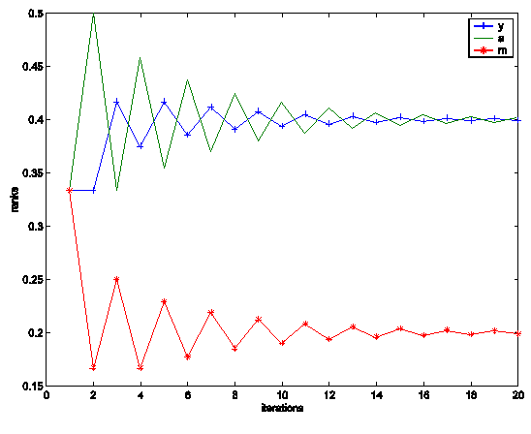
The matlab program
The rank values fluctuate, then reach a steady state
M=[1/2,1/2,0; 1/2,0,0; 0,1/2,1];
r=[1/3;1/3;1/3]
interval=1:20;
for i=interval
x(i)=r(1);
y(i)=r(2);
z(i)=r(3);
r=M*r
end;
Plot (interval, x, '+-', interval, y,'-', interval, z,'*-');

Slide 15
Questions to be answered
Will the iteration converge? Or continue infinitely?
When will it converge?
When it converges, is there an intuitive interpretation for the values of r?
Will it converge to one vector, or multiple vectors?
If it converges, how many steps does it take?

Slide 16
Random Walk Interpretation
Imagine a random web surfer
  At any time t, surfer is on some page P
  At time t+1, the surfer follows an outlink from P uniformly at random
  Ends up on some page Q linked from P
  Process repeats indefinitely
Let p(t) be a vector whose ith component is the probability that the surfer is at page i at time t
  p(t) is a probability distribution on pages
1/3
1/3
1/3

Slide 17
The stationary distribution
Where is the surfer at time t+1?
  Follows a link uniformly at random
  p(t+1) = Mp(t)
Suppose the random walk reaches a state such that
  p(t+1) = Mp(t) = p(t)
  Then p(t) is called a stationary distribution for the random walk
Our rank vector r satisfies Mr=r
So it is a stationary distribution for the random surfer
The limiting r is an eigenvector of M
  v is an eigenvector of M if Mv=λv
r is also the principal eigenvector
  The associated eigenvalue is the largest

Slide 18
Existence and Uniqueness
A central result from the theory of random walks (aka Markov processes):
  For graphs that satisfy certain conditions, the stationary distribution is unique and eventually will be reached no matter what the initial probability distribution at time t = 0.
Strongly connected
Aperiodic: return to state i can occur any time
  Bipartite graph is periodic with period 2.
y/2
yahoo
a/2
y/2
amazon
a/2
microsoft
m

Slide 19
Spider trap
y/2
A group of pages is a spider trap if there are no links from within the group to outside the group
  Random surfer gets trapped
Spider traps violate the conditions needed for the random walk theorem
yahoo
a/2
y/2
a/2
amazon
microsoft
m

Slide 20
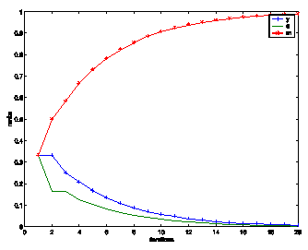
Microsoft becomes a spider trap…
y/2
yahoo
a/2
y/2
a/2
amazon
microsoft
m
Both yahoo and amazon have zero pageRank
The spider trap can contain a group of pages

Slide 21
Random teleporting
The Google solution for spider traps
At each time step, the random surfer has two options:
  With probability b, follow a link at random
  With probability 1-b, jump to some page uniformly at random
  Common values for b are in the range 0.8 to 0.9
Surfer will teleport out of spider trap within a few time steps

Slide 22
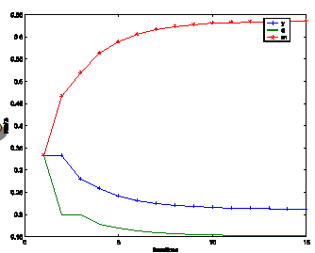
Random teleports (beta=0.8)
0.8*1/2
yahoo
0.2*1/3
0.8*1/2
0.2*1/3
0.2*1/3
amazon
microsoft

Slide 23
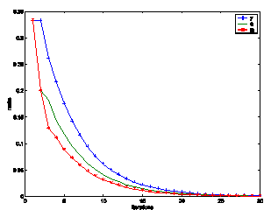
Dead end
0.8*1/2
yahoo
0.2*1/3
y 7/15 7/15 1/15
a 7/15 1/15 1/15
m 1/15 7/15 1/15
0.8*1/2
0.2*1/3
0.2*1/3
amazon
microsoft

Slide 24
Dealing with dead-ends
Teleport
  Follow random teleport links with probability 1.0 from dead-ends
  Adjust matrix accordingly
Prune and propagate
  Preprocess the graph to eliminate dead-ends
  Might require multiple passes
  Compute page rank on reduced graph
  Approximate values for dead ends by propagating values from reduced graph

Slide 25
Summarize PageRank
Derived from Markov chain
Importance (prestige, authority) of the page is the probability to reach the page in random walk
Power method is used to calculate the probability
when it is Ergodic Markov chain
  It converges
  It converges to a unique value
  It converges quickly
  Need to deal with non-Ergodic Markov chain in practice
    Random teleporting makes the states (pages) connected
    Dead end page makes the matrix no longer stochastic

Slide 26
Simple Pagerank in java
http://introcs.cs.princeton.edu/java/16pagerank/
Using Matlab or Octave
  Using power iteration
  Calculate the eigenvector

Slide 27
Pagerank: Issues and Variants
How realistic is the random surfer model?
  What if we modeled the back button?
  Surfer behavior sharply skewed towards short paths
  Search engines, bookmarks & directories make jumps non-random.
Biased Surfer Models
  Weight edge traversal probabilities based on match with topic/query (non-uniform edge selection)
  Bias jumps to pages on topic (e.g., based on personal bookmarks & categories of interest)

Slide 28
The reality
Pagerank is used in google, but is hardly the full story of ranking
  Many sophisticated features are used
  Some address specific query classes
  Machine learned ranking heavily used
Pagerank still very useful for things like crawl policy

Slide 29
Topic Specific Pagerank
Sec. 21.2.3
Goal – pageRank values that depend on query topic
  Query “random walk” most probably in academia
Topic-specific ranking: use a random surfer who teleports, with say 10% probability, using the following rule:
    Selects a topic
      say, one of the 16 top level ODP (Open Directory Project) categories based on a query & user -specific distribution over the categories
    Teleport to a page uniformly at random within the chosen topic
For topic-specific query, it is hard to implement: can’t compute PageRank at query time

Slide 30
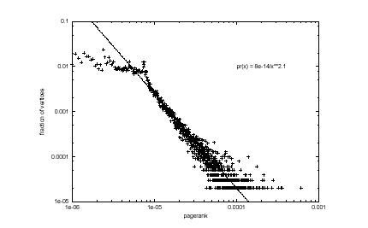
pageRank in real world
Log Plot of PageRank Distribution of Brown Domain (*.brown.edu)
G.Pandurangan, P.Raghavan,E.Upfal,”Using PageRank to characterize Webstructure” ,COCOON 2002

Slide 31
Google’s secret list (from searchengineland.com)
Eric Schmidt, Sept 16, 2010
  Presence of search term in HTML title tag
  Use of bold around search term
  Use of header tags around search term
  Presence of search term in anchor text leading to page
  PageRank of a page
  PageRank / authority of an entire domain
  Speed of web site
  …

Slide 32
There are 200 variables in google algorithm
At PubCon, Matt Cutts mentioned that there were over 200 variables in the Google Algorithm
Domain
- Age of Domain
- History of domain
- KWs in domain name
- Sub domain or root domain?
- TLD of Domain
- IP address of domain
- Location of IP address / Server
Architecture
- HTML structure
- Use of Headers tags
- URL path
- Use of external CSS / JS files
Content
- Keyword density of page
- Keyword in Title Tag
- Keyword in Meta Description (Not Meta Keywords)
- Keyword in KW in header tags (H1, H2 etc)
- Keyword in body text
- Freshness of Content
Per Inbound Link
- Quality of website/page linking in
- Age of website /page
- Relevancy of page’s content
- Location of link (Footer, Navigation, Body text)
- Anchor text if link
- Title attribute of link
- Alt tag of images linking
- Country specific TLD domain
- Authority TLD (.edu, .gov)
- Location of server
- Authority Link (CNN, BBC, etc)
Cluster of Links
- Uniqueness of Class C address.
Internal Cross Linking
- No. of internal links to page
- Location of link on page
- Anchor text of FIRST text link (Bruce Clay’s point at PubCon)
Penalties
- Over Optimisation
- Purchasing Links
- Selling Links
- Comment Spamming
- Cloaking
- Hidden Text
- Duplicate Content
- Keyword stuffing
- Manual penalties
- Sandbox effect (Probably the same as age of domain)
Miscellaneous
- JavaScript Links
- No Follow Links
Pending
- Performance / Load of a website
- Speed of JS
Misconceptions
- XML Sitemap (Aids the crawler but doesn’t help rankings)
- PageRank (General Indicator of page’s performance)

Slide 33
Web search, SEO, Spam
Slides adapted from
  Information Retrieval and Web Search, Stanford University, Christopher Manning and Prabhakar Raghavan
  CS345A, Winter 2009: Data Mining. Stanford University, Anand Rajaraman, Jeffrey D. Ullman

Slide 34
Spam (SEO)
Spamming = any deliberate action solely in order to boost a web page’s position in search engine results, incommensurate with page’s real value
Spam = web pages that are the result of spamming
This is a very broad definition
SEO (search engine optimization) industry might disagree!
Approximately 10-15% of web pages are spam
Spamming also happens in online social networks

Slide 35
Motivation for SEO and/or SPAM
You have a page that will generate lots of revenue for you if people visit it.
  Commercial, political, religious, lobbies
Therefore, you would like to direct visitors to this page.
One way of doing this: get your page ranked highly in search results.
How can I get my page ranked highly?
  Contractors (Search Engine Optimizers) for lobbies, companies
  Web masters
  Hosting services

Slide 36
Spamming techs
Boosting techniques
  Techniques for achieving high relevance/importance for a web page
  Term (content) spamming
    Manipulating the text of web pages in order to appear relevant to queries
  Link spamming
    Creating link structures that boost page rank or hubs and authorities scores
Hiding techniques
  Techniques to hide the use of boosting
    From humans and web crawlers

Slide 37
Term Spamming
Repetition
  of one or a few specific terms
  Goal is to subvert TF/IDF ranking schemes, so that the ranking is increased
  First generation engines relied heavily on tf/idf
  e.g. The top-ranked pages for the query maui resort were the ones containing the most maui’s and resort’s
  Often, the repetitions would be in the same color as the background of the web page
    Repeated terms got indexed by crawlers
    But not visible to humans on browsers
Dumping
  of a large number of unrelated terms
  e.g., copy entire dictionaries, so that the page is matched no matter what is the query

Slide 38
Term spam target
Body of web page
Title
URL
HTML meta tags
Anchor text

Slide 39
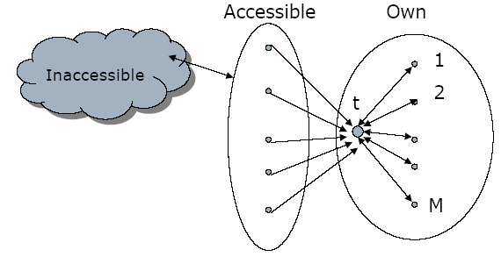
Link spam
Three kinds of web pages from a spammer’s point of view
  Inaccessible pages
  Accessible pages
    e.g., web log comments pages
    spammer can post links to his pages
  Own pages
    Completely controlled by spammer
May span multiple domain names

Slide 40
Link farm
Create lots of links pointing to the page you want to promote
Put these links on pages with high (or at least non-zero) PageRank
  Newly registered domains (domain flooding)
  A set of pages that all point to each other to boost each other’s PageRank (mutual admiration society)
  Pay somebody to put your link on their highly ranked page
  Leave comments that include the link on blogs

Slide 41
Hiding techniques
Content hiding
  Use same color for text and page background
  Stylesheet tricks
  …
Cloaking
  Return different page to crawlers and browsers
  Serve fake content to search engine spider
  DNS cloaking: Switch IP address. Impersonate
SPAM
Y
Is this a Search
Engine spider?
N
Real
Doc

Slide 42
Detecting spam
Term spamming
  Analyze text using statistical methods e.g.,Naïve Bayes classifiers
  Similar to email spam filtering
  Also useful: detecting approximate duplicate pages
Link spamming
  Open research area
  One approach: TrustRank

Slide 43
The war against spam
Spam recognition by machine learning
  Training set based on known spam
Family friendly filters
  Linguistic analysis, general classification techniques, etc.
  For images: flesh tone detectors, source text analysis, etc.
Editorial intervention
  Blacklists
  Top queries audited
  Complaints addressed
  Suspect pattern detection
Quality signals - Prefer authoritative pages based on:
  Votes from authors (linkage signals)
  Votes from users (usage signals)
Policing of URL submissions
  Anti robot test
Limits on meta-keywords
Robust link analysis
  Ignore statistically implausible linkage (or text)
  Use link analysis to detect spammers (guilt by association)

