Slide 1
214 review

Slide 2
What we have learnt
Generate scanner and parser
We do not program directly
Instead we write the specifications for the scanner and parser
Describe specification using (formal) grammar
Grammar for scanner is simpler (regular grammar)
Grammar for parser is more complex (CFG)
Programming languages are defined using BNF and EBNF
Understand how grammar is translated into program
RE→NFA→DFA→Minimization
CFG→LALR Diagram→ Shift/reduce or reduce/reduce conflict
We can write the assignments
We can write the grammars
We can debug,
and write a similar tool in the future

Slide 3
What else we can learn
Deal with the complexity of programming
Formalize the problem
Divide the problem into smaller ones
Compiler → scanner → RE → NFA→ DFA
Find an algorithm to solve the problem
RE→NFA→DFA …
Develop a generic solution for a wide range of problems
generate a parser for any language
Guarantee the solution is always correct
Repetitive code is always saved

Slide 4
What makes a good programmer (from c2.com)
"We will encourage you to develop the three great virtues of a programmer: laziness, impatience, and hubris." -- LarryWall, ProgrammingPerl , OreillyAndAssociates
Laziness
The quality that makes you go to great effort to reduce overall energy expenditure. It makes you write labor-saving programs that other people will find useful, and document what you wrote so you don't have to answer so many questions about it.
Impatience
The anger you feel when the computer is being lazy. This makes you write programs that don't just react to your needs, but actually anticipate them.
Hubris
Excessive pride. Also the quality that makes you write (and maintain) programs that other people won't want to say bad things about.

Slide 5
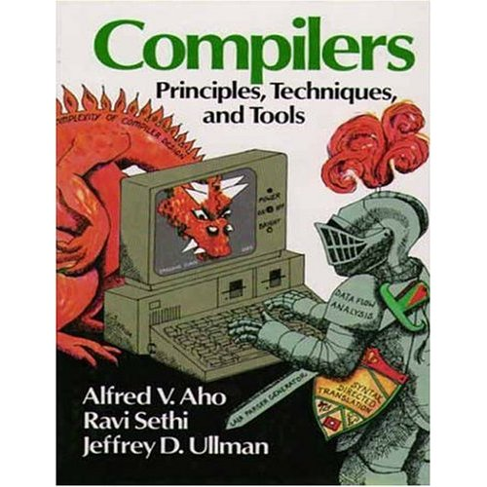
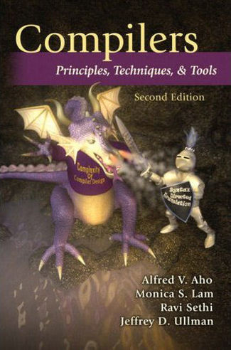

Slide 6
Valid topics
Anything that was mentioned in the lectures
Also check lecture slides
Assignments will be tested

Slide 7
Important topics
Lexing
RE, NFA, DFA
RE to NFA, NFA to DFA, DFA minimization
Parsing
CFG
LL parsing
LR parsing
Understand grammar
Write a grammar
Write a parser or translator
Understand how parser works
Shift/reduce conflicts

Slide 8
Lexing
What is lexing? what is a lexer?
How does a lexer relate to NFA/DFA theory?
How does a lexer fit in with the rest of a compiler?
What is a regular language?
How do you write a regular expression, based on a narrative description of the pattern?
How do you make an NFA based on an RE?
How to transform NFA to DFA?
How to minimize DFA?
How is an NFA different from a DFA?

Slide 9
Parsing
What is a context-free grammar?
What is the grammar hierarchy?
What is parsing? What is a parser?
How does a parser relate to CFG theory?
What is a leftmost derivation and rightmost derivation?
What is a parse tree?
What is ambiguity? How to remove ambiguity?

Slide 10
LL parsing
What is FIRST()?
What is FOLLOWS()?
How do you fix left recursion?
How do you fix common prefixes?
How do you build a parse table?
How do you run an LL parser?

Slide 11
LR parsing
What is a shift/reduce conflict?
How do you fix a shift/reduce conflict?
What is LR(0) configuration (item)? What is LR(1) item?
What is CLOSURE()?
What is Successor(S, A)?
How to draw transition diagram for LR(0), SLR, LR(1)?
How to construct parsing table for LR(0), SLR, LR(1)?
How to run LR(0)/SLR/LR(1) parser?
How to decide whether a grammar is LR(0)/SLR/LR(1)?
What is the difference between LR(0), SLR, LR(1) and LALR?
Which LR algorithm does javaCUP, yacc use?

Slide 12
LL(1)
Given the grammar
A→aA|bA|b
Whether is it an LL(1) grammar? Why?
If not, can you change that to an LL(1) grammar?
Answer:
It is not an LL(1) grammar, because there is a conflict in the LL(1) parse table
Modified grammar:
A→aA | bA’
A’→A|ε
 | a | b | $
A | A→aA | A→bA A→b
 | a | b | $
A | A→aA | A→bA’
A’ | A’→A | A’→A | A’→ε

Slide 13
Is the grammar LR(0)?
A→aA|bA|b
It is not LR(0) because there is a conflict in state S4
S1:
S’ → A•
Stack | Input | action
S0 | aab$ | S2
S0 S2a | ab$ | S2
S0 S2a S2a | b$ | S4
S0 S2a S2a S4b | $ | R A→b
S0 S2a S2a S3A | $ | R A→aA
S0 S2a S3A | $ | R A→aA
S0 S1 | $ | accept
A
S2:
A→ a•A
A→• aA
A→• bA
A→• b
A
S3:
A→aA •
S0:
S' → • A
A→ • aA
A→ • bA
A→• b
a
a
b
S4:
A→b●A
A→b•
A→•aA
A→●bA
A→•b
A
S5:
A→bA•
b
b

Slide 14
Is the grammar LR(0)?
A→aA|bA|b
It is not LR(0) because there is a conflict in state S4
S1:
S’ → A •
Stack | Input | action
S0 | abb$ | S2
S0 S2a | bb$ | S4
S0 S2a S4b | b$ | S4 or Reduce?
S0 S2a S4b | b $ | If R, A→b
S0 S2a S3A | b $ | R A→aA
S0 S1A | b $ | ?
A
S2:
A→ a•A
A→• aA
A→• bA
A→• b
A
S3:
A→aA •
S0:
S' → • A
A→ • aA
A→• bA
A→• b
a
a
b
S4:
A→b●A
A→b•
A→•aA
A→●bA
A→•b
A
S5:
A→bA•
b
b

Slide 15
Whether it is LR(0)?
A→Aa
A→Ab
A→b
S1:
S’ → A ●
A→A • a
A→A • b
S3:
A→Aa •
a
A
S2:
A→ Ab•
b
S0:
S' → • A
A→ • Aa
A→ •Ab
A→• b
Stack | Input | action
S0 | bab$ | S4
S0S4 | ab$ | R A→b
S0S1 | ab$ | S3
S0S1S3 | b $ | R A→Aa
S0S1 | b $ | S2
S0 S1S2 | $ | R A→Ab
S0S1 | $ | Accept
a
a
b
S4:
A→b•

Slide 16
S→cAd
A→ab|a
w=cad
S
S
S
c
A
d
c
A
d
c
A
d
a
b
a
cad
cad
cad
cad
16

Slide 17
Is the grammar LL(1)?
S’→S
S→cAd
A→ab|a
It is not LL(1)
because the LL(1) parsing table has conflict; OR
Because it is not left factored
 | a | b | c | d | $
S’ |  |  | S’→S
S |  |  | S→cAd
A | A→ab A→a

Slide 18
Is it LR(0)? SLR?
S’→S
S→cAd
A→ab|a
S1:
S’ → S ●
Stack | Input | action
S0 | cad$ | S2
S0 S2c | ad$ | S3
S0 S2c S3a | d$ | Reduce not Shift
S0 S2c S5A | d $ | S6
S0 S2c S5A S6d | $ | R S→cAd
S0 S1 | $ | Accept
S
S2:
S→ c • Ad
A→• ab
A→• a
S0:
S' → • S
S→• cAd
c
a
S3:
A→a●b
A→a •
A
b
S5:
S→cA●d
S4:
A→ab•
d
S6:
S→cAd •

Slide 19
Sample questions

Slide 20
JLex specification defines a
Context Free Grammar;
Regular Grammar;
Context Sensitive Grammar;
None of the above.
JLex specification has ____ parts, separated by %%.
Two;
Three;
Four;
Five;
None of the above.

Slide 21
JLex does not deal with:
DFA minimization;
CFG;
NFA to DFA transformation;
Lexical analysis;
None of the above.
A JavaCup specification defines a
Context Free Grammar;
Regular Grammar;
Context Sensitive Grammar;
None of the above.

Slide 22
Suppose that you have a grammar that can give two different derivations for the same sentence. Is that grammar ambiguous?
Definitely yes;
Definitely no;
There is no enough information to tell;
It can’t have two derivations;
None of the above.

Slide 23
With an ambiguous grammar, how many parse trees are there for any sentence that is not in the language?
0;
exactly 1;
more than 1;
1 or more;
None of the above.

Slide 24
Given a grammar that contains the following production rule, where A is a nonterminal and a and b are terminals:
A → aAa|abba
According to Chomsky hierarchy, the grammar is in
Level 0;
Level 1;
Level 2;
Level 3.
None of the above.

Slide 25
Which of the following is not involved in compiler construction:
Lexical analysis;
Linear analysis;
Code generation;
Semantic analysis;
None of the above.

Slide 26
Given the following rules of a grammar, where A and B are non-terminals, a and b are terminals, and A is the start symbol:
A → aB|bB
B → aB|bB
Which of the following regular expression can recognize the same language?
(a|b)+
(a|b)+abb
(a|b)(a|b)+
ab(a|b)+
None of the above.

Slide 27
Answer true or false for the following questions:
(0|1)* = ((1|0)*)*
For every language, there is an unambiguous grammar.
JLex is used to generate a parser from a JLex specification.
Consider the following grammar where S is a non-terminal, if, then, and else are terminals.
S→if then | if then else | ε
Whether the grammar is ambiguous?.
YACC is a parser generator.
Top down parsing method has the name because it scans input file from top to down.

Slide 28
In the following grammars E is a non terminal and ID is a terminal.
Remove the left recursion of the following grammar.
E → E+ID | ID
Write the result of the left factoring of the following grammar
E→ID+E | ID

Slide 29
Some solutions not so good
swap E and ID
E→ID+E|ID
Indirect left recursion
E→E’+ID | ID
E’→E
E→A|ID
A→E+ID

Slide 30
Acronyms
FSM
NFA/DFA
BNF
LL
LR
LALR
…

Slide 31
Given the following transition diagram. Write the corresponding regular expression.
c
S
A
b
B
a

Slide 32
Given the following grammar, where A is a non-terminal, a and b are terminals:
A→aA|bA|b
Write the regular expression that can recognize the same language.

Slide 33
Given the regular expression (ab)*. Write the corresponding regular grammar. Note that you will not get any marks if the grammar is not regular.
Some incorrect answers:
A→abA|ε
A→BA|ε
B→ab

Slide 34
Write a CFG for the following languages over alphabet {a, b}:
Palindromes, i.e., strings read the same backward and forward, such as “aaa”, “aabbabbaa”.

Slide 35
Given the following production rule, where E is a non-terminal, and identifier is a terminal. Is it an ambiguous grammar? Explain your conclusion.
E → E * E | identifier
Rewrite the grammar into an unambiguous one

Slide 36
Given the following grammar
E→TE’
E’→+TE’|ε
T→FT’
T’→*FT’|ε
F→(E)|id
What are the values in First(T)?
What are the values in Follow(T)?

Slide 37
Given the regular expression (a|b)*a(a|b).
Draw the corresponding NFA diagram using the Thompson construction;
Derive the DFA from obtained above;
Minimize the DFA.
You need to write the derivation steps in (b) and (c).

Slide 38
